Slide 1
Packet Network Performance
* Three main metrics
** Throughput – rate at which we can move data across a network.
** Delay – Time required for packet to go from end-to-end.
** Data loss – Fraction of data that is corrupted or discarded by network.
* What constrains network performance?
** Physical infrastruture – data rate of network links, propagation delay of signals,
interference/noise.
** Competing traffic – creates queuing delays, packet loss due to queue overflow.
* Providing performance guarantees
** Requires reserving network capacity for specific traffic streams.
** Can be done in packet networks and is done with many private networks- no
support for this in public internet.

Slide 2
Delays in Networks
* Speed-of-light delay
** In fiber, about 130000 miles/s.
** NY to LA is about 5000 km, so 23ms. (but network links add distance making
30 ms a better estimate).
* Transmission delay – determined by data rate of links
** On 1 Mb/s link, takes 10 ms to send a 10000 bit packet.
** On 10 Gb/s link takes 1 micro sec, and on 50 Kb/s links takes 200 ms.
* Queuing delays
** Each link in a network is preceded by a queue.
*** Implemented using memory.
*** Packets must wait for those ahead of them in the queue.
** Depends on number/length of packets in queue and link speed.
** For lightly loaded links, rarely more than 10 packets in queue.
** On overloaded links, queuing delays may exceed 100 ms.

Slide 3

Delays in Networks
transmission
A
propagation
B
nodal
processing
queueing
Total Delay= P_{D}+Q_{D}+T_{D}+Prop_{D}
T_{D} = L/R, Where L = Packet length, R = Link bandwidth (bps)
Prop_{D} = d/s Where d = distance of link, s = propagation speed in medium
Q_{D} = a L/R Where L = Packet length, R = Link bandwidth (bps) and a =
Average packet arrival rate.
* La/R ~ 0 : avg. Queuing delay is small.
* La/R -> 1 : avg. Queuing delay is large.
* La/R > 1 : more work is arriving than can be serviced, avg. Delay is
infinite.

Slide 4
Other Sources of delay
* Packetization delay – time to acquire data to be sent
** voice typically encoded at 32 Kb/s (4 bytes per milliseconds).
** So, if we limit packetization delay to 20 ms, each packet carries 80 bytes of
voice data.
** An internet packet has about 50 bytes of “overhead” (40% of total).
** Can reduce overhead percentage by increasing delay.
** For telephony, need to limit delay for good user experience.
* Component processing delay
** Components like routers, wireless access points and hosts consume some
time processing packets.
*** for routers this includes checking packets for errors and determining where
they should go next.
** added to other delays (like queuing , transmission).
** typically fairly small: 1-10 micro seconds for routers, 10-50 micro seconds for
hosts.

Slide 5
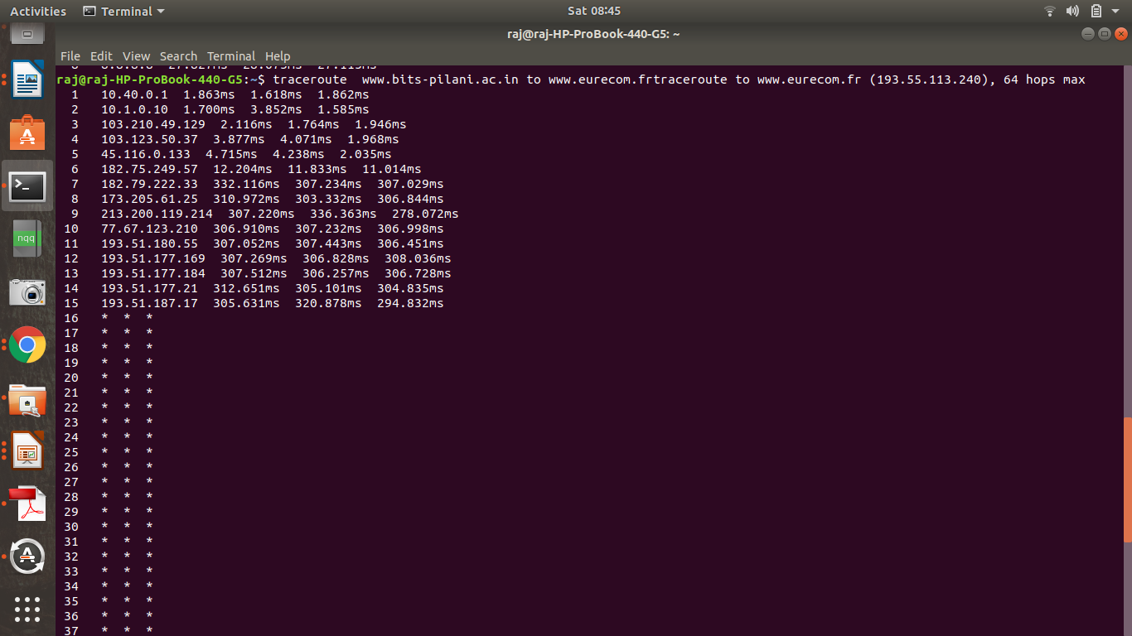
End-To-End Delay
3 probes
3 probes
3 probes

Slide 6
Packet loss
* Bits corrupted on links
** very rare in fiber – typically, less than 1 bit in 10^12 have errors.
** Far more frequent in wireless – one in 10^3 to one in 10 ^5.
*** also highly variable: interference, distance from access point.
*** can reduce using varity of coding techniques.
** Electrical signals over wire – intermediate error rates.
** Errors detected by routers, which discard corrupted packets.
* Losses due to lack of space in packet queues
** can be kept close to zero if traffic flows are regulated to avoid overloads.
** but very common in internet (packet loss rates of 2-20% are not unusual).
* Components like routers may corrupt packet data
** Extremely rare in correctly functioning components.

Slide 7
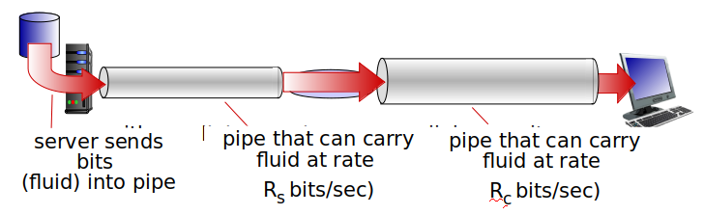
Throughput
* Rate (bits/time unit) at which bits transferred between sender/receiver.
* Instantaneous : rate at given point in time
* Average : rate over longer period of time

Slide 8
Suppose Host A wants to send a large file to Host B. The path from Host A to Host B has four links, of rates R1 = 500 kbps, R2 = 2 Mbps, R3 = 1 Mbps and R4=3Mbps. Assuming no other traffic in the network, what is the throughput for the file transfer?
Answer: 500 kbps
Consider a LAN with a maximum distance of 2km. At what bandwidth would propagation
delay (at a speed of 1 x 10⁸ m/s) equals to transmit delay for 100-byte packets? What about 512-byte packets?.

Slide 9
Solution
prop delay = distance / prop speed
= 2 * 10^3 m / 1 * 10^8 mps = 1 * 10^-5 s = 20 us
trans time = size / bandwidth
For an 800 bit packet
= 800 b / x Mbps = 20 us
x = 40 Mbps= 5MBps
For a 4096 bit packet
x = approx 204.5 Mbps= 25.6 MBps

Slide 10
OSI Reference Model
The International Standards Organization (ISO) proposal for the standardization of various protocols used in computer networks is called the Open Systems Interconnection Reference Model.
Although the OSI model is a just a model (not a specification), it is generally regarded as the most complete model.

Slide 11
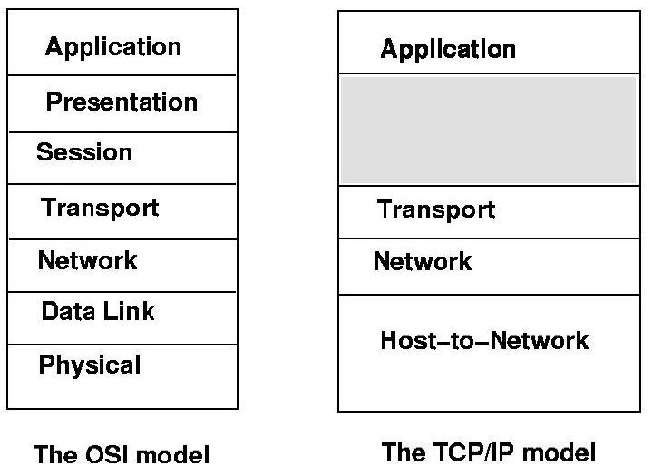
OSI Reference Model

Slide 12
Application Layer:
  The Application Layer is where users interact with the system.
  Applications such as Telnet, FTP, SMTP, mail, http, live at this layer.
  The Application layer is responsible for coding the message.
  An Application Layer Header is added to the data.
Presentation Layer:
  Translation, cryptography, and code conversion take place at this level.
  A common Language is determined.
  Data Compression occurs.
  Data Encryption occurs.
  Big endians, little endians: data can be encoded prior to transmission data can be decoded upon receipt.
Session Layer:
  Managing dialog control: Traffic can go in both directions at the same time, or in only one direction at a time.
  Token management: both sides do not attempt the same operation at the same time.
  Synchronization:Insertion of checkpoints to determine portions of transmissions.

Slide 13
Transport Layer:
  Frees upper layers from the concerns of achieving data transfer.
  The transport layer deals with accepting data from its higher layer, splitting it up into smaller units if necessary, and then passing these units to the network layer.
  This layer also ensures that all of the units arrive correctly at the other end, and that all of this is done efficiently and in such a way as to isolate the upper layers.
  Design issues include:
    Connection orientation
    Flow control:The issue of ensuring that a fast machine does not swamp a slow machine, must be considered.
    The possible use of multiple connections: Normally, the transport layer creates a distinct network connection for each connection required by the session layer.
    The possible use of multiplexing: If high throughput is required, and multiple connections are too expensive, then may multiplex several connections onto the same connection.
    Controlling congestion.
    What type of service to provide: point-to-point isolated messages broadcast

Slide 14
Network Layer:
  The network layer deals with controlling the operation of the subnet.
  The subnet contains switching elements and hosts between two computers.
  Design issues include:
    How to route packets from a source to a destination (routing). There may be many paths depending upon network topology.
    Controlling congestion
    Accounting functions
    Different addressing and size requirements, and protocols used when interconnecting heterogeneous networks (translation between different network types).
    packet headers
    virtual circuits

Slide 15
Data Link Layer:
  The data link layer deals with taking a raw transmission facility and transforming it into a line that appears free of undetected transmission errors to the network layer.
  Design issues include:
    Frame boundaries: The data link layer performs its primary task by breaking the input data into frames.
    Possible errors in frame data: A noise burst on the line can completely destroy a frame.
    Transmission rate: Some traffic regulation mechanism must be employed to ensure that a very fast machine doesn't send data at such a high rate that it "swamps" the receiving machine.
    How to resolve competition for the line when full duplex transmission is used.
Physical Layer:
  The physical layer deals with the transmission of raw bits over a communication channel.
  Mechanical, electrical and procedural interfaces, the transmission medium.

Slide 16
Some apps
E-mail
Web
text messaging
remote login
P2P file sharing
multi-user network games
streaming stored video (YouTube, Hulu, Netflix)
voice over IP (e.g., Skype)
real-time video conferencing
social networking
search

Slide 17
Creating a network app
write programs that:
run on (different) end systems
communicate over network
e.g., web server software communicates with browser software
no need to write software for network-core devices:
network-core devices do not run user applications
applications on end systems allows for rapid app development, propagation

Slide 18
Application architectures
possible structure of applications:
Client-server
peer-to-peer (P2P)

Slide 19
Client-server architecture
server:
always-on host
permanent IP address
data centers for scaling
clients:
communicate with server
may be intermittently connected
may have dynamic IP addresses
do not communicate directly with each other
client/server

Slide 20
P2P architecture
no always-on server
arbitrary end systems directly communicate
peers request service from other peers, provide service in return to other peers
  self scalability – new peers bring new service capacity, as well as new service demands
peers are intermittently connected and change IP addresses
  complex management
peer2peer

Slide 21
Processes communicating
clients, Servers
process: program running within a host
within same host, two processes communicate using inter-process communication (defined by OS)
processes in different hosts communicate by exchanging messages
client process: process that initiates communication
server process: process that waits to be contacted
aside: applications with P2P architectures have client processes & server processes

Slide 22

Sockets
process sends/receives messages to/from its socket
socket analogous to door
  sending process shoves message out door
  sending process relies on transport infrastructure on other side of door to deliver message to socket at receiving process
application
socket
application
controlled by
app developer
process
process
transport
transport
network
network
controlled
by OS
link
Internet
link
physical
physical

Slide 23
Addressing processes
to receive messages, process must have identifier
host device has unique 32-bit IP address
Q: does IP address of host on which process runs suffice for identifying the process?
identifier includes both IP address and port numbers associated with process on host.
example port numbers:
  HTTP server: 80
  mail server: 25
to send HTTP message to gaia.cs.umass.edu web server:
  IP address: 128.119.245.12
  port number: 80
  A: no, many processes can be running on same host

Slide 24
App-layer protocol defines
types of messages exchanged,
  e.g., request, response
message syntax:
  what fields in messages & how fields are delineated
message semantics
  meaning of information in fields
rules for when and how processes send & respond to messages
open protocols:
defined in RFCs
allows for interoperability
e.g., HTTP, SMTP
proprietary protocols:
e.g., Skype

Slide 25
What transport service does an app need?
throughput
some apps (e.g., multimedia) require minimum amount of throughput to be “effective”
other apps (“elastic apps”) make use of whatever throughput they get
data integrity
some apps (e.g., file transfer, web transactions) require 100% reliable data transfer
other apps (e.g., audio) can tolerate some loss
timing
security
encryption, data integrity, …

Slide 26
Transport service requirements: common apps
application
file transfer
e-mail
Web documents
real-time audio/video
stored audio/video
interactive games
text messaging
data loss
no loss
no loss
no loss
loss-tolerant
loss-tolerant
loss-tolerant
no loss
throughput
elastic
elastic
elastic
audio: 5kbps-1Mbps
video:10kbps-5Mbps
same as above
few kbps up
elastic
time sensitive
no
no
no
yes, 100’s msec
yes, few secs
yes, 100’s msec
yes and no

Slide 27
Internet apps: application, transport protocols
application
layer protocol
SMTP [RFC 2821]
Telnet [RFC 854]
HTTP [RFC 2616]
FTP [RFC 959]
HTTP (e.g., YouTube),
RTP [RFC 1889]
SIP, RTP, proprietary
(e.g., Skype)
underlying
transport protocol
TCP
TCP
TCP
TCP
TCP or UDP
TCP or UDP
application
e-mail
remote terminal access
Web
file transfer
streaming multimedia
Internet telephony

Slide 28
Web and HTTP
web page consists of objects
object can be HTML file, JPEG image, Java applet, audio file,…
web page consists of base HTML-file which includes several referenced objects
each object is addressable by a URL, e.g.,
www.someschool.edu/someDept/pic.gif
host name
path name

Slide 29

HTTP overview
HTTP: hypertext transfer protocol
Web’s application layer protocol
client/server model
  client: browser that requests, receives, (using HTTP protocol) and “displays” Web objects
  server: Web server sends (using HTTP protocol) objects in response to requests
HTTP request
PC running
Firefox browser
HTTP response
HTTP request
server
running
Apache Web
server
HTTP response
iphone running
Safari browser

Slide 30
HTTP overview (cont..)
uses TCP:
client initiates TCP connection (creates socket) to server, port 80
server accepts TCP connection from client
HTTP messages (application-layer protocol messages) exchanged between browser (HTTP client) and Web server (HTTP server)
TCP connection closed
HTTP is “stateless”
server maintains no information about past client requests
aside
protocols that maintain “state” are complex!
past history (state) must be maintained
if server/client crashes, their views of “state” may be inconsistent, must be reconciled

Slide 31
HTTP connections
non-persistent HTTP
at most one object sent over TCP connection
  connection then closed
downloading multiple objects required multiple connections
persistent HTTP
multiple objects can be sent over single TCP connection between client, server

Slide 32
Non-persistent HTTP
suppose user enters URL:
(contains text,
references to 10
jpeg images)
www.someSchool.edu/someDepartment/home.index
1a. HTTP client initiates TCP connection to HTTP server (process) at www.someSchool.edu on port 80
1b. HTTP server at host www.someSchool.edu waiting for TCP connection at port 80. “accepts” connection, notifying client
2. HTTP client sends HTTP request message (containing URL) into TCP connection socket. Message indicates that client wants object someDepartment/home.index
3. HTTP server receives request message, forms response message containing requested object, and sends message into its socket
time

Slide 33
Non-persistent HTTP (cont.)
4. HTTP server closes TCP connection.
5. Steps 1-5 repeated for each of 10 jpeg objects

Slide 34
Non-persistent HTTP: response time
RTT (definition): time for a small packet to travel from client to server and back
HTTP response time:
one RTT to initiate TCP connection
one RTT for HTTP request and first few bytes of HTTP response to return
file transmission time
non-persistent HTTP response time =
2RTT+ file transmission time
initiate TCP
connection
RTT
request
file
RTT
time to
transmit
file
file
received
time
time

Slide 35
Persistent HTTP
non-persistent HTTP issues:
requires 2 RTTs per object
OS overhead for each TCP connection
browsers often open parallel TCP connections to fetch referenced objects
persistent HTTP:
server leaves connection open after sending response
subsequent HTTP messages between same client/server sent over open connection
client sends requests as soon as it encounters a referenced object
as little as one RTT for all the referenced objects

Slide 36
HTTP request message
two types of HTTP messages: request, response
HTTP request message:
  ASCII (human-readable format)
carriage return character
request line
(GET, POST,
HEAD commands)
line-feed character
GET /index.html HTTP/1.1\r\n
Host: www-net.cs.umass.edu\r\n
User-Agent: Firefox/3.6.10\r\n
Accept: text/html,application/xhtml+xml\r\n
Accept-Language: en-us,en;q=0.5\r\n
Accept-Encoding: gzip,deflate\r\n
Accept-Charset: ISO-8859-1,utf-8;q=0.7\r\n
Keep-Alive: 115\r\n
Connection: keep-alive\r\n
\r\n
header
lines
carriage return,
line feed at start
of line indicates
end of header lines

Slide 37
Method types
HTTP/1.0:
GET
POST
HEAD
  asks server to leave requested object out of response
HTTP/1.1:
GET, POST, HEAD
PUT
  uploads file in entity body to path specified in URL field
DELETE
  deletes file specified in the URL field

Slide 38
HTTP response message
status line
(protocol
status code
status phrase)
HTTP/1.1 200 OK\r\n
Date: Sun, 26 Sep 2010 20:09:20 GMT\r\n
Server: Apache/2.0.52 (CentOS)\r\n
Last-Modified: Tue, 30 Oct 2007 17:00:02 GMT\r\n
ETag: "17dc6-a5c-bf716880"\r\n
Accept-Ranges: bytes\r\n
Content-Length: 2652\r\n
Keep-Alive: timeout=10, max=100\r\n
Connection: Keep-Alive\r\n
Content-Type: text/html; charset=ISO-8859-1\r\n
\r\n
data data data data data ...
header
lines
data, e.g.,
requested
HTML file

Slide 39
HTTP response status codes
status code appears in 1st line in server-to-client response message.
some sample codes:
200 OK
  request succeeded, requested object later in this msg
301 Moved Permanently
  requested object moved, new location specified later in this msg (Location:)
400 Bad Request
  request msg not understood by server
404 Not Found
  requested document not found on this server
505 HTTP Version Not Supported

Slide 40
User-server state: cookies
example:
Susan always access Internet from PC
visits specific e-commerce site for first time
when initial HTTP requests arrives at site, site creates:
  unique ID
  entry in backend database for ID
many Web sites use cookies
four components:
1) cookie header line of HTTP response message
2) cookie header line in next HTTP request message
3) cookie file kept on user’s host, managed by user’s browser
4) back-end database at Web site

Slide 41
Cookies: keeping “state” (cont.)
client
server
ebay 8734
usual http request msg
Amazon server
creates ID
1678 for user
cookie file
usual http response
set-cookie: 1678
backend
database
create
entry
ebay 8734
amazon 1678
usual http request msg
cookie: 1678
cookie-
specific
action
access
usual http response msg
one week later:
access
ebay 8734
amazon 1678
usual http request msg
cookie: 1678
cookie-
specific
action
usual http response msg

Slide 42
Cookies (cont..)
aside
what cookies can be used for:
authorization
shopping carts
recommendations
user session state (Web e-mail)
cookies and privacy:
cookies permit sites to learn a lot about you
you may supply name and e-mail to sites
how to keep “state”:
protocol endpoints: maintain state at sender/receiver over multiple transactions
cookies: http messages carry state

Slide 43
More about Web caching
cache acts as both client and server
  server for original requesting client
  client to origin server
typically cache is installed by ISP (university, company, residential ISP)
why Web caching?
reduce response time for client request
reduce traffic on an institution’s access link
Internet dense with caches: enables “poor” content providers to effectively deliver content (so too does P2P file sharing)

Slide 44

Web caches (proxy server)
goal: satisfy client request without involving origin server
user sets browser: Web accesses via cache
browser sends all HTTP requests to cache
  object in cache: cache returns object
  else cache requests object from origin server, then returns object to client
HTTP request
HTTP request
HTTP request
proxy
server
client
origin
server
HTTP response
HTTP response
HTTP response
client
origin
server

Slide 45
Conditional GET
client
server
Goal: don’t send object if cache has up-to-date cached version
  no object transmission delay
  lower link utilization
cache: specify date of cached copy in HTTP request
If-modified-since: <date>
server: response contains no object if cached copy is up-to-date:
HTTP/1.0 304 Not Modified
HTTP request msg
If-modified-since: <date>
object
not
modified
before
<date>
HTTP response
HTTP/1.0
304 Not Modified
HTTP request msg
If-modified-since: <date>
object
modified
after
<date>
HTTP response
HTTP/1.0 200 OK
<data>

Slide 46
DNS: domain name system
people: many identifiers:
  SSN, name, passport #
Internet hosts, routers:
  IP address (32 bit) - used for addressing datagrams
  “name”, e.g., www.yahoo.com - used by humans
Q: how to map between IP address and name, and vice versa ?
Domain Name System:
distributed database implemented in hierarchy of many name servers
application-layer protocol: hosts, name servers communicate to resolve names (address/name translation)
  note: core Internet function, implemented as application-layer protocol
  complexity at network’s “edge”

Slide 47
DNS: services, structure
DNS services
hostname to IP address translation
host aliasing
  canonical, alias names
mail server aliasing
load distribution
  replicated Web servers: many IP addresses correspond to one name
why not centralize DNS?
single point of failure
traffic volume
distant centralized database
maintenance

Slide 48
DNS: a distributed, hierarchical database
Root DNS Servers
…
…
com DNS servers
org DNS servers
edu DNS servers
yahoo.com
DNS servers
pbs.org
DNS servers
poly.edu
DNS servers
umass.edu
DNS servers
amazon.com
DNS servers
client wants IP for www.amazon.com; 1st approx:
client queries root server to find com DNS server
client queries .com DNS server to get amazon.com DNS server
client queries amazon.com DNS server to get IP address for www.amazon.com

Slide 49

DNS: root name servers
contacted by local name server that can not resolve name
root name server:
  contacts authoritative name server if name mapping not known
  gets mapping
  returns mapping to local name server
c. Cogent, Herndon, VA (5 other sites)
d. U Maryland College Park, MD
h. ARL Aberdeen, MD
j. Verisign, Dulles VA (69 other sites )
k. RIPE London (17 other sites)
i. Netnod, Stockholm (37 other sites)
e. NASA Mt View, CA
f. Internet Software C.
Palo Alto, CA (and 48 other sites)
m. WIDE Tokyo
(5 other sites)
13 root name “servers” worldwide
a. Verisign, Los Angeles CA
(5 other sites)
b. USC-ISI Marina del Rey, CA
l. ICANN Los Angeles, CA
(41 other sites)
g. US DoD Columbus, OH (5 other sites)

Slide 50
TLD, authoritative servers
top-level domain (TLD) servers:
  responsible for com, org, net, edu, aero, jobs, museums, and all top-level country domains, e.g.: uk, fr, ca, jp
  Network Solutions maintains servers for .com TLD
  Educause for .edu TLD
authoritative DNS servers:
  organization’s own DNS server(s), providing authoritative hostname to IP mappings for organization’s named hosts
  can be maintained by organization or service provider

Slide 51
Local DNS name server
does not strictly belong to hierarchy
each ISP (residential ISP, company, university) has one
  also called “default name server”
when host makes DNS query, query is sent to its local DNS server
  has local cache of recent name-to-address translation pairs (but may be out of date!)
  acts as proxy, forwards query into hierarchy

Slide 52
DNS name
resolution example
root DNS server
2
host at cis.poly.edu wants IP address for gaia.cs.umass.edu
3
TLD DNS server
4
5
iterated query:
contacted server replies with name of server to contact
“I don’t know this name, but ask this server”
local DNS server
dns.poly.edu
7
6
1
8
authoritative DNS server
dns.cs.umass.edu
requesting host
cis.poly.edu
gaia.cs.umass.edu

Slide 53
DNS name
resolution example
root DNS server
2
3
recursive query:
puts burden of name resolution on contacted name server
heavy load at upper levels of hierarchy?
7
6
TLD DNS
server
local DNS server
dns.poly.edu
5
4
1
8
authoritative DNS server
dns.cs.umass.edu
requesting host
cis.poly.edu
gaia.cs.umass.edu

Slide 54
DNS: caching, updating records
once (any) name server learns mapping, it caches mapping
  cache entries timeout (disappear) after some time (TTL)
  TLD servers typically cached in local name servers
    thus root name servers not often visited
cached entries may be out-of-date (best effort name-to-address translation!)
  if name host changes IP address, may not be known Internet-wide until all TTLs expire
update/notify mechanisms proposed IETF standard
  RFC 2136

Slide 55
DNS records
DNS: distributed db storing resource records (RR)
RR format: (name, value, type, ttl)
type=A
  name is hostname
  value is IP address
type=CNAME
  name is alias name for some “canonical” (the real) name
  www.ibm.com is really
servereast.backup2.ibm.com
  value is canonical name
type=NS
  name is domain (e.g., foo.com)
  value is hostname of authoritative name server for this domain
type=MX
  value is name of mailserver associated with name

Slide 56
DNS protocol, messages
query and reply messages, both with same message format
2 bytes
2 bytes
msg header
identification: 16 bit # for query, reply to query uses same #
flags:
  query or reply
  recursion desired
  recursion available
  reply is authoritative
identification
flags
# questions
# answer RRs
# authority RRs
# additional RRs
questions (variable # of questions)
answers (variable # of RRs)
authority (variable # of RRs)
additional info (variable # of RRs)

Slide 57
Attacking DNS
DDoS attacks
Bombard root servers with traffic
  Not successful to date
  Traffic Filtering
  Local DNS servers cache IPs of TLD servers, allowing root server bypass
Bombard TLD servers
  Potentially more dangerous
Redirect attacks
Man-in-middle
  Intercept queries
DNS poisoning
  Send bogus relies to DNS server, which caches
Exploit DNS for DDoS
Send queries with spoofed source address: target IP
Requires amplification

Slide 58
TCP: Overview
point-to-point:
  one sender, one receiver
reliable, in-order byte stream:
  no “message boundaries”
pipelined:
  TCP congestion and flow control set window size
full duplex data:
  bi-directional data flow in same connection
  MSS: maximum segment size
connection-oriented:
  handshaking (exchange of control msgs) inits sender, receiver state before data exchange
flow controlled:
  sender will not overwhelm receiver

Slide 59
TCP segment structure
32 bits
URG: urgent data
(generally not used)
counting
by bytes
of data
(not segments!)
source port #
dest port #
sequence number
ACK: ACK #
valid
acknowledgement number
head
len
not
used
U
receive window
A
PSH: push data now
(generally not used)
P
R
S
F
# bytes
rcvr willing
to accept
checksum
Urg data pointer
RST, SYN, FIN:
connection estab
(setup, teardown
commands)
options (variable length)
application
data
(variable length)
Internet
checksum
(as in UDP)

Slide 60
TCP seq. numbers, ACKs
outgoing segment from sender
sequence numbers:
  byte stream “number” of first byte in segment’s data
acknowledgements:
  seq # of next byte expected from other side
  cumulative ACK
Q: how receiver handles out-of-order segments
  A: TCP spec doesn’t say, - up to implementor
source port #
dest port #
sequence number
acknowledgement number
rwnd
checksum
urg pointer
window size
N
sender sequence number space
sent
ACKed
sent, not-yet ACKed
(“in-flight”)
usable
but not
yet sent
not
usable
incoming segment to sender
source port #
dest port #
sequence number
acknowledgement number
A
rwnd
checksum
urg pointer

Slide 61
TCP reliable data transfer
TCP creates rdt service on top of IP’s unreliable service
  pipelined segments
  cumulative acks
  single retransmission timer
retransmissions triggered by:
  timeout events
  duplicate acks
let’s initially consider simplified TCP sender:
  ignore duplicate acks
  ignore flow control, congestion control

Slide 62
TCP sender events:
data rcvd from app:
create segment with seq #
seq # is byte-stream number of first data byte in segment
start timer if not already running
  think of timer as for oldest unacked segment
  expiration interval: TimeOutInterval
timeout:
retransmit segment that caused timeout
restart timer
ack rcvd:
if ack acknowledges previously unacked segments
  update what is known to be ACKed
  start timer if there are still unacked segments

Slide 63
Connection Management
before exchanging data, sender/receiver “handshake”:
agree to establish connection (each knowing the other willing to establish connection)
agree on connection parameters
application
application
connection state: ESTAB
connection variables:
seq # client-to-server
server-to-client
rcvBuffer size
at server,client
connection state: ESTAB
connection Variables:
seq # client-to-server
server-to-client
rcvBuffer size
at server,client
network
network
Socket clientSocket =
newSocket("hostname","port number");
Socket connectionSocket = welcomeSocket.accept();

Slide 64
TCP 3-way handshake
client state
server state
LISTEN
LISTEN
choose init seq num, x
send TCP SYN msg
SYNSENT
SYNbit=1, Seq=x
choose init seq num, y
send TCP SYNACK
msg, acking SYN
SYN RCVD
SYNbit=1, Seq=y
ACKbit=1; ACKnum=x+1
received SYNACK(x)
indicates server is live;
send ACK for SYNACK;
this segment may contain
client-to-server data
ESTAB
ACKbit=1, ACKnum=y+1
received ACK(y)
indicates client is live
ESTAB

Slide 65
TCP: closing a connection
client, server each close their side of connection
  send TCP segment with FIN bit = 1
respond to received FIN with ACK
  on receiving FIN, ACK can be combined with own FIN
simultaneous FIN exchanges can be handled

Slide 66
TCP: closing a connection
client state
server state
ESTAB
ESTAB
clientSocket.close()
FIN_WAIT_1
can no longer
send but can
receive data
FINbit=1, seq=x
CLOSE_WAIT
ACKbit=1; ACKnum=x+1
can still
send data
FIN_WAIT_2
wait for server
close
LAST_ACK
FINbit=1, seq=y
TIMED_WAIT
can no longer
send data
ACKbit=1; ACKnum=y+1
timed wait
for 2*max
segment lifetime
CLOSED
CLOSED

